Slide 1
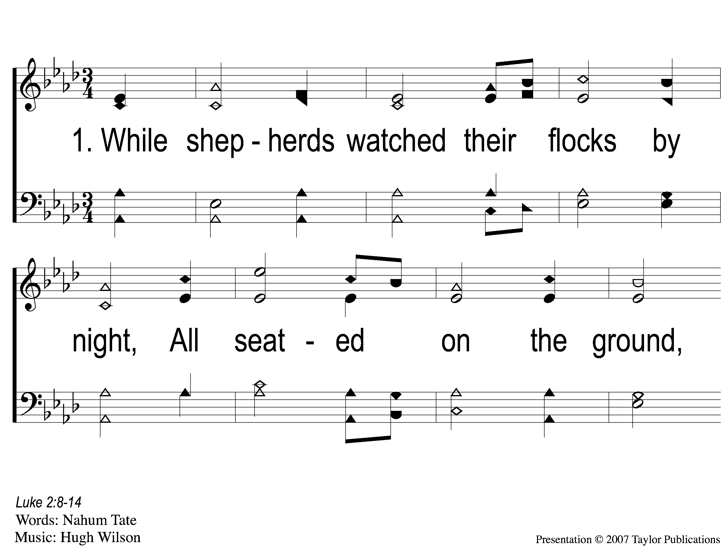
1-1 While Shepherds Watch
While Shepherds Watch
71

Slide 2
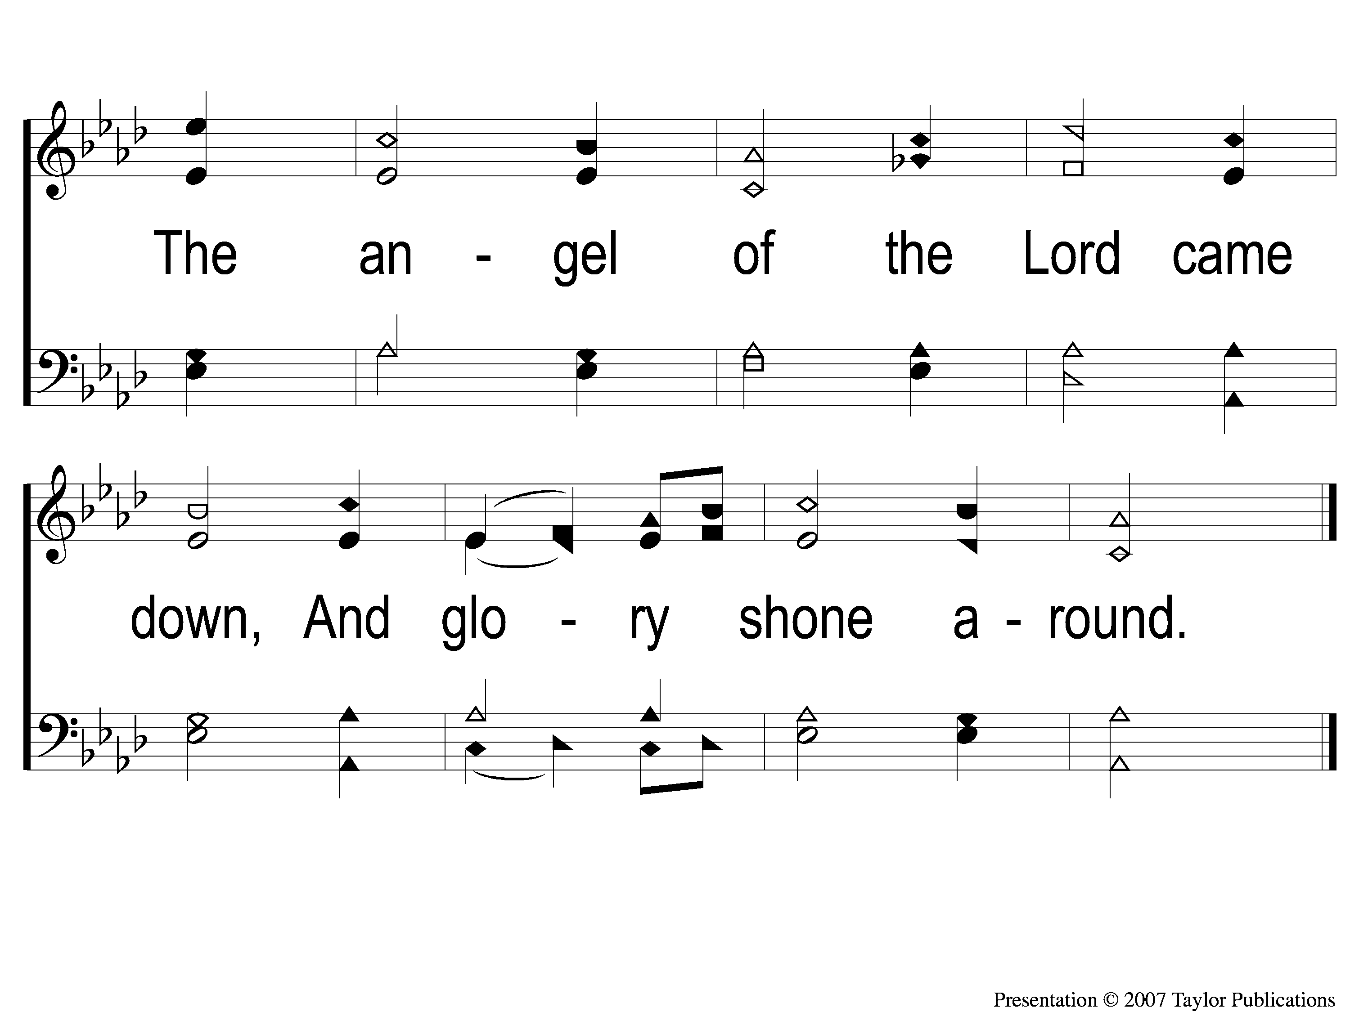
1-2 While Shepherds Watch
While Shepherds Watch
71

Slide 3
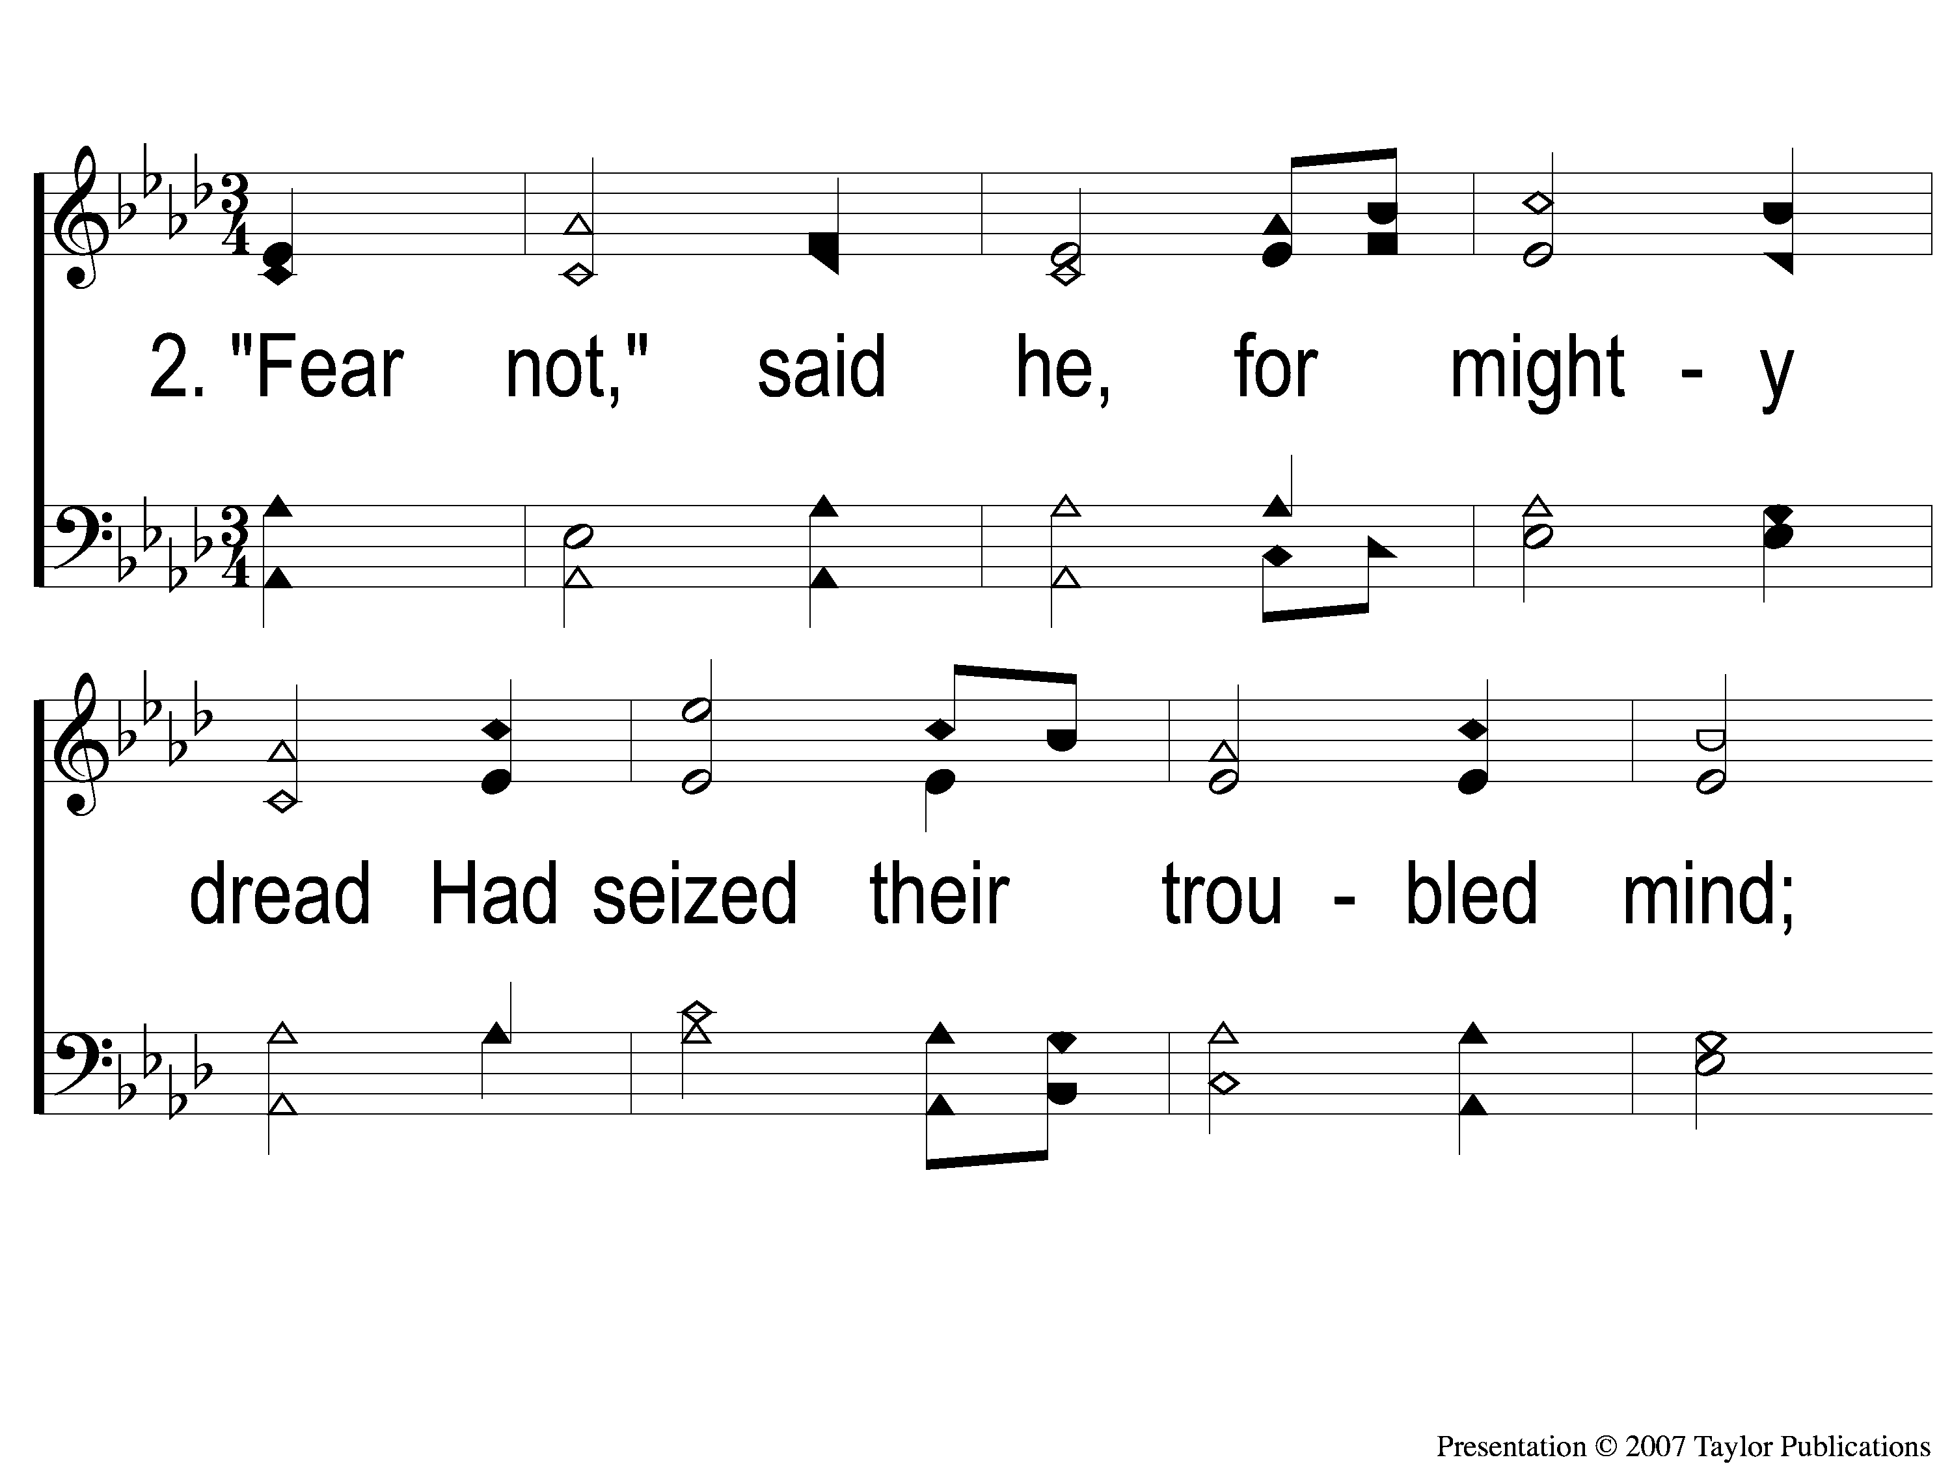
2-1 While Shepherds Watch
While Shepherds Watch
71

Slide 4
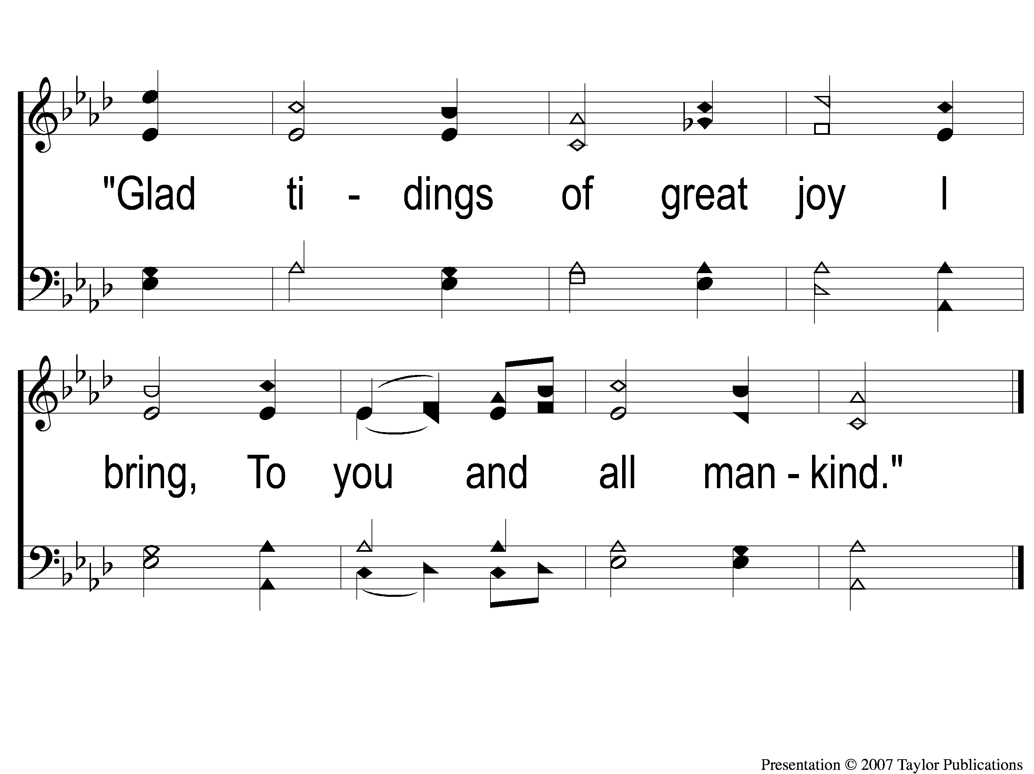
2-2 While Shepherds Watch
While Shepherds Watch
71

Slide 5
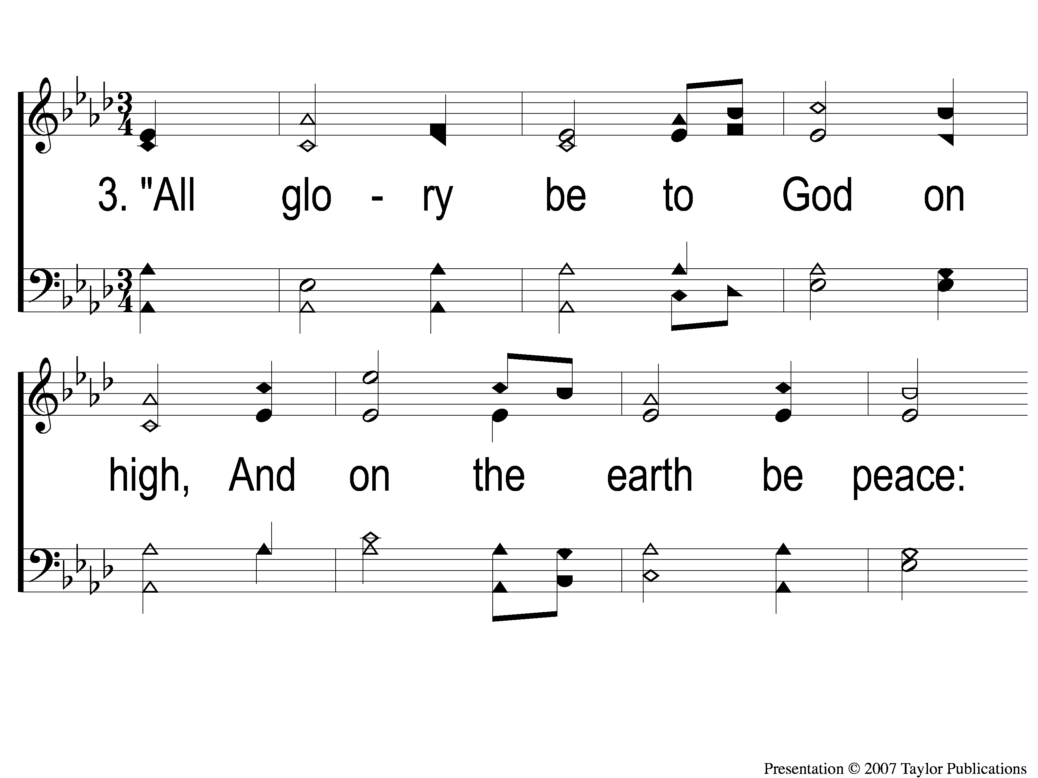
3-1 While Shepherds Watch
While Shepherds Watch
71

Slide 6
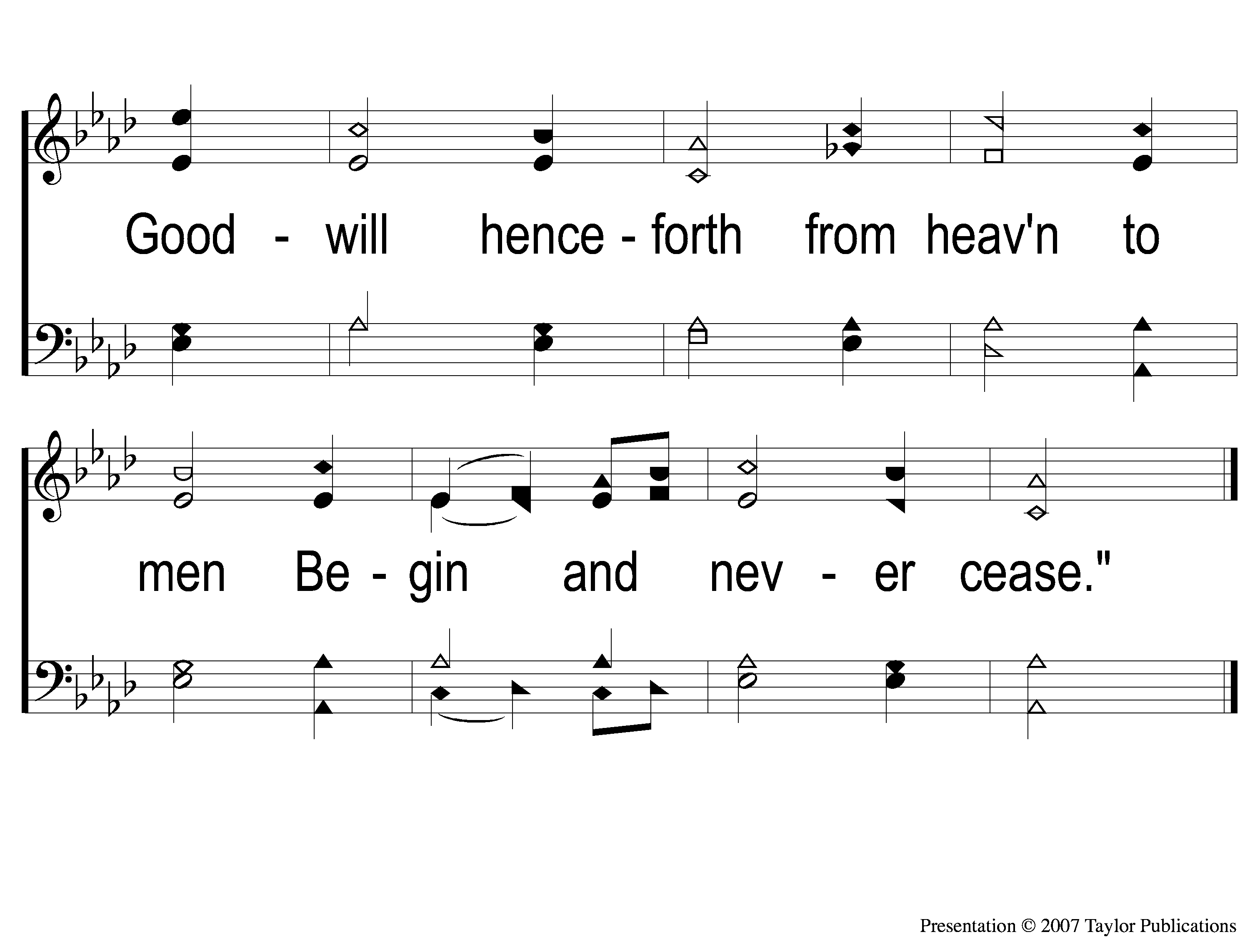
3-2 While Shepherds Watch
While Shepherds Watch
71

